Slide 1
Spring Budget Forum​
June 6, 2024

Slide 2
Today’s Topics
Introduction
Enrollment update
Brief Review: Fiscal Year 2022-2023 actual revenues and expenditures
Fiscal Year 2023-2024 budget review
Fiscal Year 2024-2025 budget plan
A look ahead at the next biennium’s budget strategy and planning

Slide 3
Year in Brief
Education =
Core Mission
Responsible
Stewards
Tightening Operations
Balanced Approach
Fiscal Realities
Transparency
Headwinds

Slide 4
Context
Enrollment
Sound Fiscal Policy
Matching budgets to known expenses

Slide 5
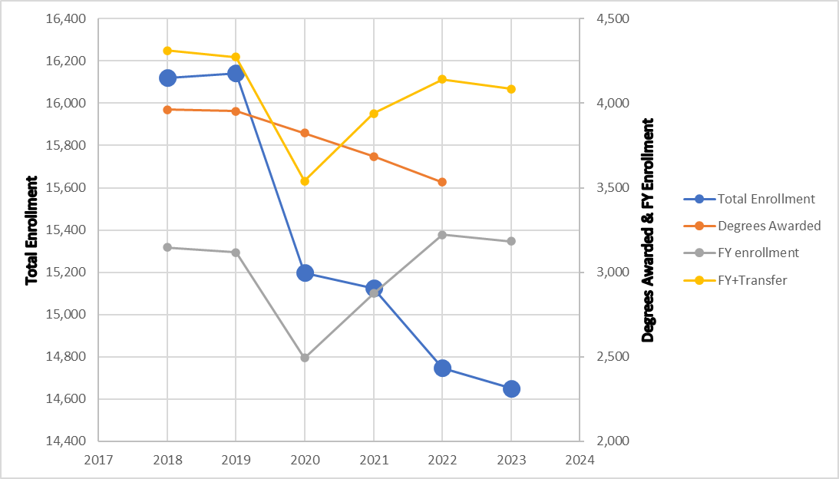
What About Enrollments

Slide 6
Western had our two largest incoming first-year classes in Fall 2022 and Fall 2023
However, total enrollment is still well below pre-pandemic numbers, and FAFSA will likely hurt enrollment
The university is trending better than many other institutions across the state and country
Enrollment
Update

Slide 7
Budget Updates
FY 2023-2024 Actuals
We are nearly at the end our fiscal year, and it is projected ending university reserves will cover approximately 7% of the operating budget.
Fiscal Year 2023-2024 Budgeting
3% across-the-board reduction was achieved by holding/folding vacancies and reducing goods and services.
Fiscal Year 2022-2023 Close Out
Ended with university expenditures exceeding revenue. The remainder of one- time federal stimulus funds and university reserves were used to cover the difference.
Thank you to everyone for their continued support to reach these targets.
The Board of Trustees adopted a policy for reserves to cover at least 10% of the operating budget by Fiscal Year 2031-2032.

Slide 8
The Full Pie: WWU Revenues by Source Fiscal Year 2022-2023 Actuals
Includes $104.4M in operating and $2.0M in capital used for maintenance

Slide 9
FY23 WWU Operating Budget – Flow of Funds
Total Revenues (Operating)
Total Expenses
(State Operating)
Made up of
Made up of
Invest. Income & Differential Tuition
$0.8M
Goods + Services $27.2M
Compliance: Accruals & Deferrals
$10.6M
Tuition + fees $117.7M
State Appropriation
$104.4M
ASA
$4.9M
Salaries + Benefits $189.1M
Fees & FA
Tuition Building Fee
Net Oper.
Tuition $93.0M
Local Operating Expenses $216.3M
Net Pension + OPEB Contra-Expense $10.5M
Local Operating $202.7M
Appropriate Earmarks
$24.7M
WESTERN WASHINGTON UNIVERSITY | MAKE WAVES.

Slide 10
Key Priorities for FY25 Budget
Fully fund instruction based on approved schedule (no AA deficit)
Fulfill commitments on compensation increases
Exercise sound fiscal policy and reserve management

Slide 11
Budget Development Timing
Compressed timeline due to FAFSA delays
WWU Policy-level investments focused entirely on base operations
WESTERN WASHINGTON UNIVERSITY | MAKE WAVES.

Slide 12
FY25 Budget Outlook
 | FY25
Starting reserves | $15,292,151
Revenues | $232,016,178
Expenditures, Including: | $235,671,631
Base (Recurring) Budget Reductions | $0
One-time Budget Reductions | ($13,741,267)
Net Change | ($3,655,452)
Ending Reserves | $11,636,699
Reserves as a % of Budget | 5.0%
New state funding for academic programming, legislative priorities, and 70% of state-authorized compensation increases (detail follows)
One-time strategies (revenues, expenditure reductions, and reserves) total $21m
Includes full costs of instruction in the expenditures
Focuses on preserving capacity for recovery
Fulfills compensation commitments
WESTERN WASHINGTON UNIVERSITY | MAKE WAVES.

Slide 13
Fiscal Year 2024-2025
Continued gap between recurring revenues and expenditures; Have identified one-time strategies, including:
Extending salary recaps on vacated positions to 6 months
Potential sale of property
Use of self-sustaining funds where appropriate
Focus is on preserving instruction and access (fully funding schedule including NTT), with an eye to recovering enrollments
Holistic look at reserves (fund balance) across the university
Optional, voluntary employee-initiated contract reductions/furloughs where mutually supported
Use of reserves
WESTERN WASHINGTON UNIVERSITY | MAKE WAVES.

Slide 14
Fiscal Year 2024-2025
New state operating funding becoming effective from biennium and supplemental:
Academic Access and Outreach, $400k (one-time)
Electrical and Computer Engineering, $445k
Special Education Teacher Residency, $1.3 million
State share of compensation increases (70% of state-adopted)

Slide 15
Looking Ahead
We will maintain a laser focus on increasing enrollment both through recruitment of new students and retention of current students.
2025-2027 State Budget Request in September will focus on more robust state funding for our core operating budget so we can be on a more sustainable budget pathway in the long term.
Assess the impacts of headwinds and mitigation strategies to address uncertainties

Slide 16
Questions
WESTERN WASHINGTON UNIVERSITY | MAKE WAVES.

Slide 17
Thank You

